Slide 1
Automatically testable apps in distributed environment
or how to test micro services (and more)
Piotr Litwinski
Software Engineer, Zartis
github: https://github.com/plitwinski

Slide 2
Agenda
What’s the problem?
Types of tests
What tools to use?
How to write automated tests?
How to test automated tests?
Summary
Pros and cons
Notes:
Idea - developers very often don’t pay much attention to testing

Slide 3
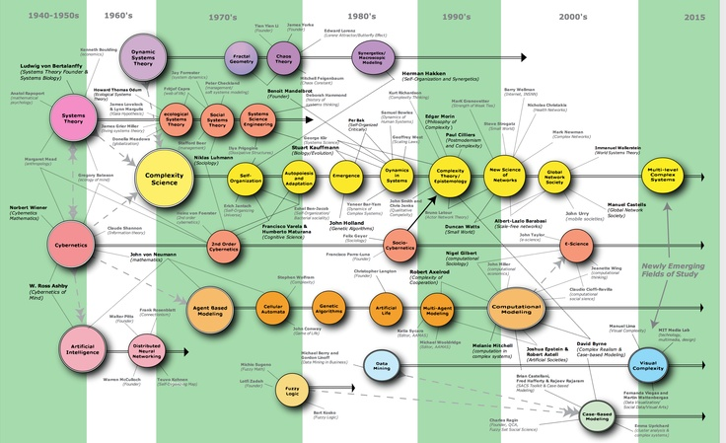
What is the problem?
Notes:
Distributed environment are big (many services and/or instances)
Management is difficult and can be error prone
Updating multiple parts of the system can be challenging.
Regression is hard and takes a lot of time (or is reduced in scope)
Roll back is usually not trivial as well

Slide 4

Types of tests

Slide 5
Build time tests
Unit tests
Contract tests
Service/Component tests (in-memory integration tests)
Classic integration tests
Notes:
Unit = well known
Contract = focused on APIs between various components (give examples)
Service/Component tests = check actual logic based on contracts (also known as coarse grain unit tests or in memory integration tests)
Classic integration tests = use real 3rd party tools to test against

Slide 6
Environmental tests
Deployed
E2E
Exploratory
Notes:
Deployed tests = verify if all’s configured in the given environment (access to data storage, 3rd party services, etc.)
E2E = check real world scenario in the environment
Exploratory = partially automated, look for uncommon use/edge cases (e.g. postman scripted tests)

Slide 7
System tests
Performance
Resilience / Availability
Notes:
Wydajnościowe = dedicated perf env and simulate real traffic to see how system behaves in various scenarios (there’s a lot of various perf tests types)
Resilience = chaos / gorilla/ kong aka chaos engineering (Netflix) – IMPORTANT fail fast & fail safe

Slide 8

What tools to use?
Notes:
Deploying whole system at once can be difficult - it’s easier to deliver smaller chunks but more often
Updating smaller parts allows to focus on a change that’s going to be delivered
Describe how CI/CD is working

Slide 9
Developer tools
In-process tools
Stubs & mocks
Coarse grained „unit” tests
Well defined contracts
In-memory testing frameworks (np.: in-memory databases, test server)
Machine level tools
Contract verification
Webdriver + (Headless) browsers
Local counterparts (np.: local sql, json server, etc.)
Easily distributable counterparts (e.g. MySQL hosted on docker)
Notes:
Contract verification = make sure contracts are met based on definitions (e.g. get latest swagger, etc.)
Local counterparts - easily work in parallel
Integration counterparts - try to avoid unless you really need to (hard to run in parallel, tend to be slower)
Contracts are EXTREMELY important!!

Slide 10
Devops tools
Tools to use after successful deployment to given environment
Deployed agent runs deployed tests in the environment
App runs it’s own diagnostics at startup (fails to start in case of errors)

Slide 11
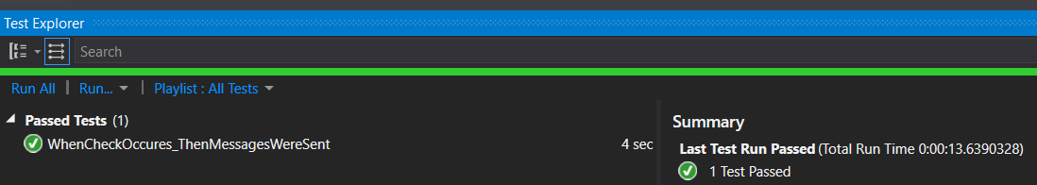
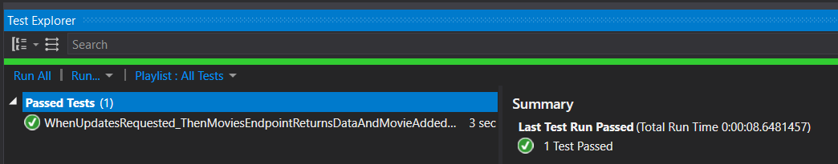
Developer tools – examples 1, 2
Coarse grained unit tests
InMemory database and test server

Slide 12
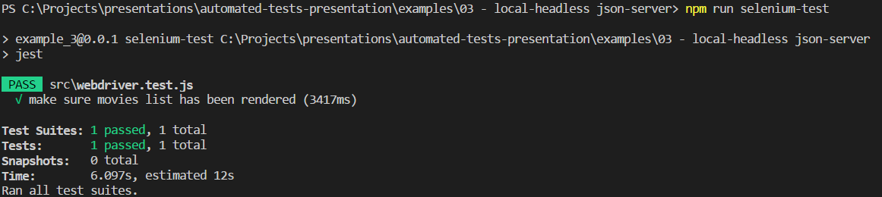
Developer tools – example 3
Selenium WebDriver + Http Server + Json Server + headless Firefox
Steps:
npm run startWebServer (in a separate process)
npm run startApi (in a separate process
npm run selenium-test (in a separate process)

Slide 13
Ops tools
Pipelines
Monitoring
Dashboards
Notes:
Pipeline = build => deploy => tests (promoted automatically or on demand)
Monitoring = check if there are no suspicious patterns, compare with past usage, etc.
Dashboards = aggregation and coordination of test results and monitoring

Slide 14

How to write automated tests?

Slide 15
Choose strategy – what is the purpose of the test(s)?
Choose methodology – test function/class/component vs scenario testing
Plan – before writing any code think about what tests are needed upfront
Modularity - use building blocks
Notes:
Choose strategy - development support (TDD), regression, main flow testing, happy/unhappy path, use case testing, red-green refactor approach, etc.
Planning - what parts are tested on which level, testing pyramid vs testing house vs testing diamond
Methodology - examples (mixed stacks)

Slide 16
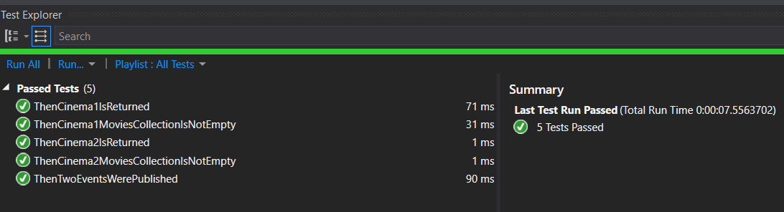
Modularity – example 4

Slide 17
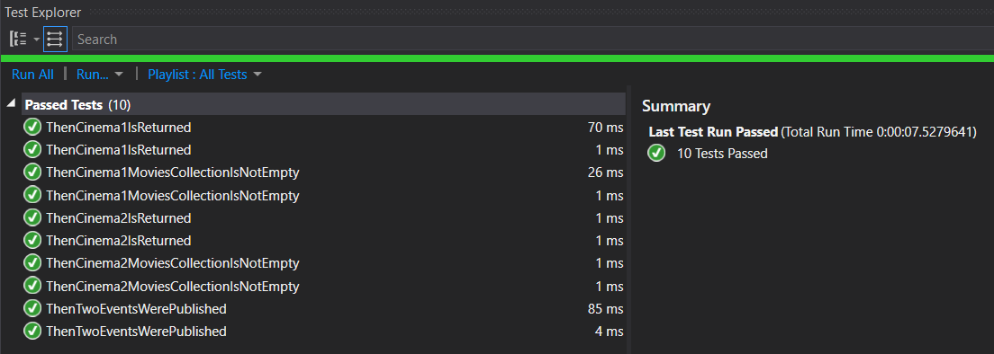
Modularity - example 5

Slide 18

How to test tests?

Slide 19
Planning
Code reviews
Metrics - keep track of bugs caused by incorrect implementation in production
Test coverage
Mutation tests
Notes:
Code reviews - good to have it thoroughly reviewed by at least 2 people

Slide 20

Summary - pros & cons
Notes:
Plan before code (what and how to test it)
Try to put as much of testing as possible into build time step
Try to reduce number of integration tests
Make sure contracts are rock solid
Automate as much as you can
Don’t forget about metrics!

Slide 21
Difficulties
Standardization and automation on a company level
More complex changes can be …. more complex
Cost (in short term) - time, tools, learning curve, training, etc.

Slide 22
Pros
Huge savings on regression
Catching up bugs much earlier
More confidence while refactoring or expanding a system
Standardization across the company
Notes:
Regression = massive cost and time reduction or not needed at all
Catching bugs early = faster feedback loop, cheaper bug fixing (e.g. less people involved)
Refactoring = higher confidence level
Standardization = much easier to shift people between teams

Slide 23

Questions?

Slide 24
Useful links
https://github.com/plitwinski/automated-tests-presentation
https://medium.com/netflix-techblog/the-netflix-simian-army-16e57fbab116
https://en.wikipedia.org/wiki/Mutation_testing
https://martinfowler.com/articles/microservice-testing

